Slide 1
Applications
Clustering

Slide 2
Outline
Clustering
Algorithm Examples Applications

Slide 3
Clustering
given N n-vectors x₁, . . . , x_{N}
goal: partition (divide, cluster) into k groups
want vectors in the same group to be close to one another

Slide 4
Example settings
topic discovery and document classification
  x_{i} is word count histogram for document i
patient clustering
  x_{i} are patient attributes, test results, symptoms
customer market segmentation
  x_{i} is purchase history and other attributes of customer i
color compression of images
  x_{i} are RGB pixel values
financial sectors
  x_{i} are n-vectors of financial attributes of company i

Slide 5
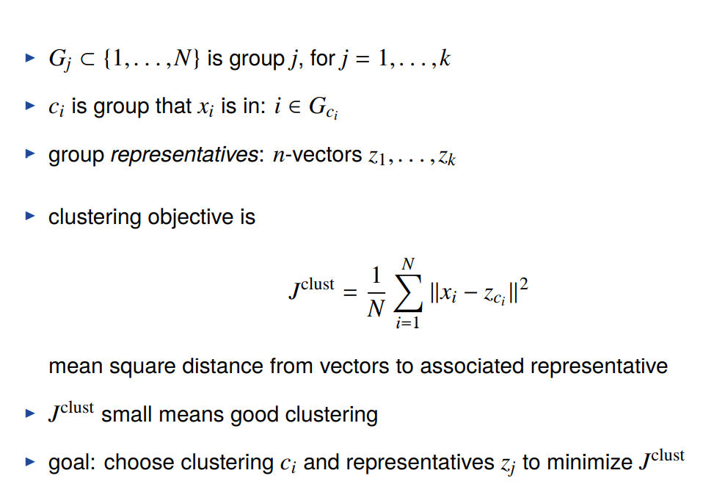
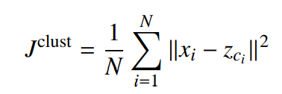
Clustering objective
G_{j} ⊂ {1, . . . , N} is group j, for j = 1, . . . , k
c_{i} is group that x_{i} is in: i ∈ G_{ci}
group representatives: n-vectors z₁, . . . , z_{k}
clustering objective is
mean square distance from vectors to associated representative
J^{clust} small means good clustering
goal: choose clustering c_{i} and representatives z_{j} to minimize J^{clust}

Slide 6
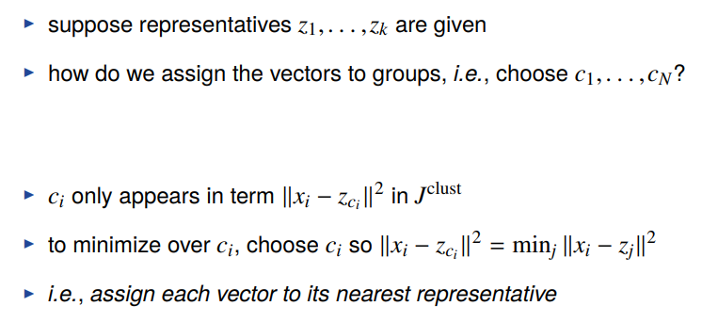
Partitioning the vectors given the representatives
suppose representatives z₁, . . . , z_{k} are given
how do we assign the vectors to groups, i.e., choose c₁, . . . , c_{N} ?
c_{i} only appears in term ǁx_{i} − z_{ci} ǁ² in J^{clust}
to minimize over c_{i}, choose c_{i} so ǁx_{i} − z_{ci} ǁ² = min_{j} ǁx_{i} − z_{j} ǁ²
i.e., assign each vector to its nearest representative

Slide 7
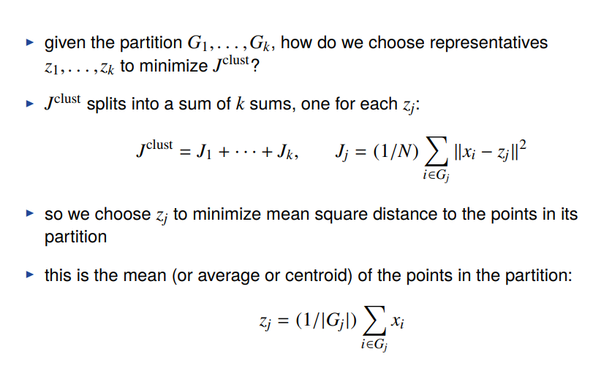
Choosing representatives given the partition
given the partition G₁,. . . , G_{k} , how do we choose representatives
z₁, . . . , z_{k} to minimize J^{clust}?
J^{clust} splits into a sum of k sums, one for each z_{j}:
X
2
J^{clust} = J₁ + · · · + J_{k}, J = (1/N) ǁx − z ǁ
j i j
i∈G_{j}
so we choose z_{j} to minimize mean square distance to the points in its partition
this is the mean (or average or centroid) of the points in the partition:
X
z = (1/|G |) x
j j i
i∈G_{j}

Slide 8
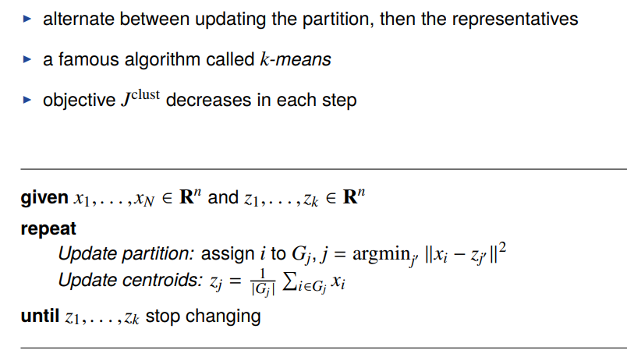
k-means algorithm
alternate between updating the partition, then the representatives
a famous algorithm called k-means
objective J^{clust} decreases in each step
given x₁, . . . , x_{N} ∈ R^{n} and z₁, . . . , z_{k} ∈ R^{n}
repeat
Update partition: assign i to Gj, j = argmin_{j}j ǁxi − zj^{j} ǁ²
.
Update centroids: z =
1
x
j
i∈G i
|G_{j} | j
until z₁, . . . , z_{k} stop changing

Slide 9
Convergence of k-means algorithm
J^{clust} goes down in each step, until the z_{j}’s stop changing
but (in general) the k-means algorithm does not find the partition that minimizes J^{clust}
k-means is a heuristic: it is not guaranteed to find the smallest possible value of J^{clust}
the final partition (and its value of J^{clust}) can depend on the initial representatives
common approach:
  run k-means 10 times, with different (often random) initial representatives
  take as final partition the one with the smallest value of J^{clust}

Slide 10
Data

Slide 11
Iteration 1

Slide 12
Iteration 2

Slide 13
Iteration 3

Slide 14
Iteration 10

Slide 15
Final clustering

Slide 16
Convergence
1.5
_{J}clust
1
0.5
1 3 5 7 9 11 13 15
Iteration

Slide 17
Outline
Clustering
Algorithm Examples Applications

Slide 18
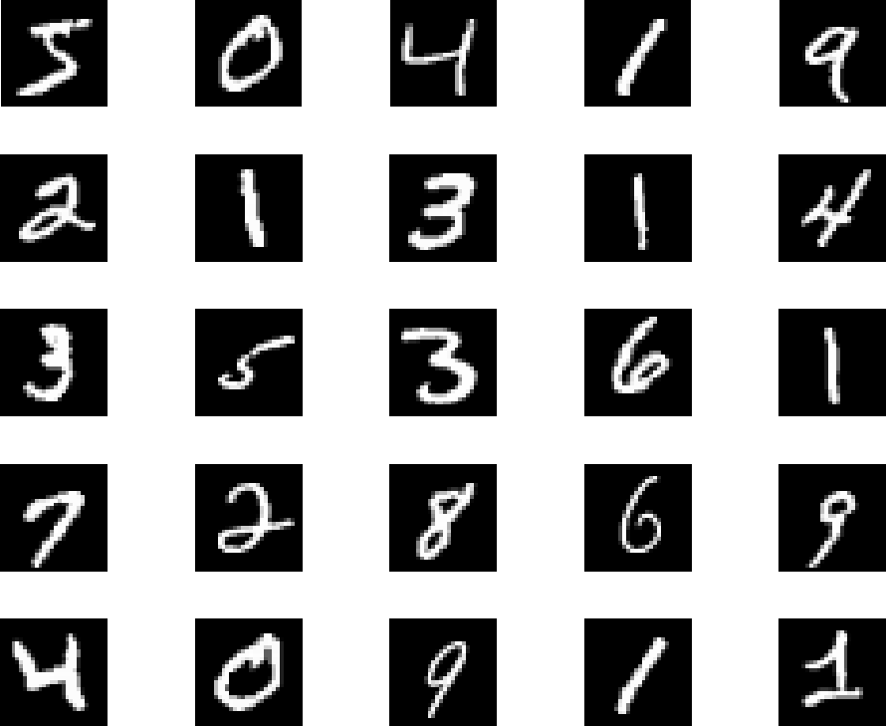
Handwritten digit image set
MNIST images of handwritten digits (via Yann Lecun)
N = 60, 000 28 × 28 images, represented as 784-vectors x_{i}
25 examples shown below

Slide 19
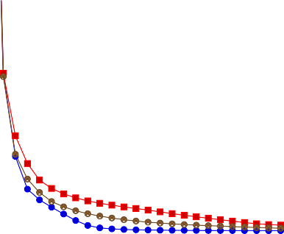
k-means image clustering
k = 20, run 20 times with different initial assignments
convergence shown below (including best and worst)
42
40
38
36
1 5 9 13 17 21 25
Iteration
_{J}clust

Slide 20
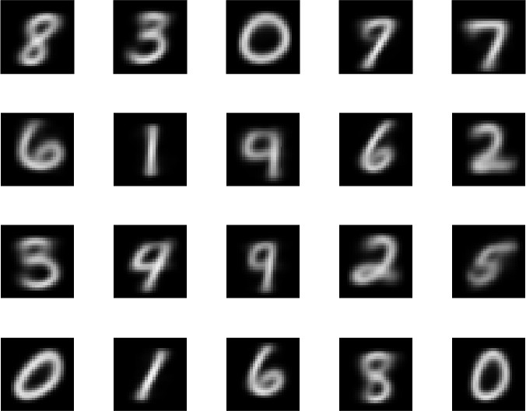
Group representatives, best clustering

Slide 21
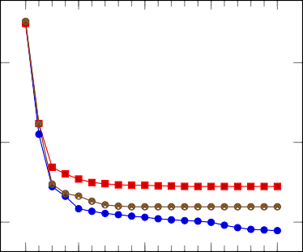
Topic discovery
N = 500 Wikipedia articles, word count histograms with n = 4423
k = 9, run 20 times with different initial assignments
convergence shown below (including best and worst)
·10⁻³
8
7.5
7
_{J}clust
1 5
10 15 20
Iteration

Slide 22
Topics discovered (clusters 1–3)
words with largest representative coefficients
Cluster 1 | Cluster 2 | Cluster 3
Word Coef. | Word Coef. | Word | Coef.
fight 0.038 | holiday 0.012 | united | 0.004
win 0.022 | celebrate 0.009 | family | 0.003
event 0.019 | festival 0.007 | party | 0.003
champion 0.015 | celebration 0.007 | president | 0.003
fighter 0.015 | calendar 0.006 | government | 0.003
titles of articles closest to cluster representative
  “Floyd Mayweather, Jr”, “Kimbo Slice”, “Ronda Rousey”, “José Aldo”, “Joe Frazier”, “Wladimir Klitschko”, “Saul Álvarez”, “Gennady Golovkin”, “Nate Diaz”, . . .
  “Halloween”, “Guy Fawkes Night” “Diwali”, “Hanukkah”, “Groundhog Day”, “Rosh Hashanah”, “Yom Kippur”, “Seventh-day Adventist Church”, “Remembrance Day”, . . .
  “Mahatma Gandhi”, “Sigmund Freud”, “Carly Fiorina”, “Frederick Douglass”, “Marco Rubio”, “Christopher Columbus”, “Fidel Castro”, “Jim Webb”, . . .

Slide 23
Topics discovered (clusters 4–6)
words with largest representative coefficients
Cluster 4 Cluster 5
Cluster 6
Word | Coef. | Word | Coef. | Word | Coef.
album | 0.031 | game | 0.023 | series | 0.029
release | 0.016 | season | 0.020 | season | 0.027
song | 0.015 | team | 0.018 | episode | 0.013
music | 0.014 | win | 0.017 | character | 0.011
single | 0.011 | player | 0.014 | film | 0.008
titles of articles closest to cluster representative
  “David Bowie”, “Kanye West” “Celine Dion”, “Kesha”, “Ariana Grande”, “Adele”, “Gwen Stefani”, “Anti (album)”, “Dolly Parton”, “Sia Furler”, . . .
  “Kobe Bryant”, “Lamar Odom”, “Johan Cruyff”, “Yogi Berra”, “José Mourinho”, “Halo 5: Guardians”, “Tom Brady”, “Eli Manning”, “Stephen Curry”, “Carolina Panthers”, . . .
  “The X-Files”, “Game of Thrones”, “House of Cards (U.S. TV series)”, “Daredevil (TV series)”, “Supergirl (U.S. TV series)”, “American Horror Story”, . . .

Slide 24
Topics discovered (clusters 7–9)
words with largest representative coefficients
Cluster 7 Cluster 8
Cluster 9
Word | Coef. | Word | Coef. | Word | Coef.
match | 0.065 | film | 0.036 | film | 0.061
win | 0.018 | star | 0.014 | million | 0.019
championship | 0.016 | role | 0.014 | release | 0.013
team | 0.015 | play | 0.010 | star | 0.010
event | 0.015 | series | 0.009 | character | 0.006
titles of articles closest to cluster representative
  “Wrestlemania 32”, “Payback (2016)”, “Survivor Series (2015)”, “Royal Rumble (2016)”, “Night of Champions (2015)”, “Fastlane (2016)”, “Extreme Rules (2016)”, . . .
  “Ben Affleck”, “Johnny Depp”, “Maureen O’Hara”, “Kate Beckinsale”, “Leonardo DiCaprio”, “Keanu Reeves”, “Charlie Sheen”, “Kate Winslet”, “Carrie Fisher”, . . .
  “Star Wars: The Force Awakens”, “Star Wars Episode I: The Phantom Menace”, “The Martian (film)”, “The Revenant (2015 film)”, “The Hateful Eight”, . . .

